Slide 1

236781
Lecture 12
Deep learning
Variational autoencoders (VAE)
Dr. Chaim Baskin

Slide 2
Outline
Variational autoencoders

Slide 3
Traning Variational autoencoders: High-level idea
At training time, jointly learn encoder and decoder by maximizing a variational bound on the data likelihood
$$z$$
$$x$$
Encoder
Decoder
$$\hat{x}$$
D. Kingma and M. Welling, Auto-Encoding Variational Bayes, ICLR 2014

Slide 4

Variational autoencoders: High-level idea
At training time, jointly learn encoder and decoder by maximizing a variational bound on the data likelihood
At test time, discard encoder and use decoder to sample from the learned distribution
$$z$$
Decoder
$$\hat{x}$$
D. Kingma and M. Welling, Auto-Encoding Variational Bayes, ICLR 2014

Slide 5
Variational autoencoders: High-level idea
Probabilistic generative model of the data distribution:
Latent code
Data point
$$z$$
$$x$$
Sample $z$ from prior $p(z)$ (usually Gaussian)
Sample $x$ from conditional $p(x|z)$
Try to approximate the conditional with neural network

Slide 6
Variational autoencoders: High-level idea
At training time, jointly learn encoder and decoder
Encoder: given inputs $x$, output $q_{φ}\left(z | x\right)$
Specifically, output mean and (diagonal) covariance, or $μ_{z|x}$ and $Σ_{z|x}$, so that $q_{φ}\left(z | x\right)=N(μ_{z|x},Σ_{z|x})$
Decoder: given $z$, output $p_{θ}\left(x | z\right)$
Specifically, output $μ_{x|z}$ and $Σ_{x|z}$ so that $p_{θ}\left(x | z\right)=N(μ_{x|z},Σ_{x|z})$
Training objective: (a bound on) data likelihood under the model
$$q_{φ}\left(z | x\right)$$
$$x$$
Encoder
Decoder
$$p_{θ}\left(x | z\right)$$

Slide 7
Variational autoencoders: High-level idea
At test time, discard encoder and use decoder to sample from $p_{θ}\left(x | z\right)=N(μ_{x|z},Σ_{x|z})$
Sample $z$ from prior (Gaussian)
$$z$$
Decoder
Sample $x$ from
$$p_{θ}\left(x | z\right)=N(μ_{x|z},Σ_{x|z})$$

Slide 8
Variational autoencoders: Training
Objective: maximize the variational lower bound on the data likelihood:
$$\log{p_{θ}\left(x\right) ≥ }𝔼_{z\sim q_{φ}(z|x)}[\log{p_{θ}(x|z)] }− D_{KL}\left(q_{φ}\left(z | x\right),p\left(z\right)\right)$$
Adapted from J. Johnson

Slide 9
Variational autoencoders: Training
Objective: maximize the variational lower bound on the data likelihood:
$$\log{p_{θ}\left(x\right) ≥ }𝔼_{z\sim q_{φ}(z|x)}[\log{p_{θ}(x|z)] }− D_{KL}\left(q_{φ}\left(z | x\right),p\left(z\right)\right)$$
Run training point $x$ through encoder to get a distribution over latent codes $z$
Adapted from J. Johnson

Slide 10
Variational autoencoders: Training
Objective: maximize the variational lower bound on the data likelihood:
$$\log{p_{θ}\left(x\right) ≥ }𝔼_{z\sim q_{φ}(z|x)}[\log{p_{θ}(x|z)] }− D_{KL}\left(q_{φ}\left(z | x\right),p\left(z\right)\right)$$
Run training point $x$ through encoder to get a distribution over latent codes $z$
Encoder output should match the prior $p\left(z\right)$
Closed form expression when $q_{φ}$ is diagonal Gaussian and $p$ is unit Gaussian (Assume $z$ has dimension $J$):
$$−D_{KL}\left(q_{φ}\left(z | x\right),p\left(z\right)\right) =\sum_{j=1}^{J}{\left(1+\log\left({\left(Σ_{z|x}\right)}_{j}^{2}\right)−{\left(μ_{z|x}\right)}_{j}^{2}−{\left(Σ_{z|x}\right)}_{j}^{2}\right)}$$
Adapted from J. Johnson

Slide 11
Variational autoencoders: Training
Objective: maximize the variational lower bound on the data likelihood:
$$\log{p_{θ}\left(x\right) ≥ }𝔼_{z\sim q_{φ}(z|x)}[\log{p_{θ}(x|z)] }− D_{KL}\left(q_{φ}\left(z | x\right),p\left(z\right)\right)$$
Run training point $x$ through encoder to get a distribution over latent codes $z$
Encoder output should match the prior $p(z)$
Sample code $z$ from encoder output
Adapted from J. Johnson

Slide 12
Variational autoencoders: Training
Objective: maximize the variational lower bound on the data likelihood:
$$\log{p_{θ}\left(x\right) ≥ }𝔼_{z\sim q_{φ}(z|x)}[\log{p_{θ}(x|z)] }− D_{KL}\left(q_{φ}\left(z | x\right),p\left(z\right)\right)$$
Run training point $x$ through encoder to get a distribution over latent codes $z$
Encoder output should match the prior $p(z)$
Sample code $z$ from encoder output
Run sampled $z$ through decoder to get a distribution over data samples
Adapted from J. Johnson

Slide 13
Variational autoencoders: Training
Objective: maximize the variational lower bound on the data likelihood:
$$\log{p_{θ}\left(x\right) ≥ }𝔼_{z\sim q_{φ}(z|x)}[\log{p_{θ}(x|z)] }− D_{KL}\left(q_{φ}\left(z | x\right),p\left(z\right)\right)$$
Run training point $x$ through encoder to get a distribution over latent codes $z$
Encoder output should match the prior $p(z)$
Sample code $z$ from encoder output
Run sampled $z$ through decoder to get a distribution over data samples
Original input should be likely under the distribution output in (4)
Adapted from J. Johnson

Slide 14
Variational autoencoders: Training
Objective: maximize the variational lower bound on the data likelihood:
$$\log{p_{θ}\left(x\right) ≥ }𝔼_{z\sim q_{φ}(z|x)}[\log{p_{θ}(x|z)] }− D_{KL}\left(q_{φ}\left(z | x\right),p\left(z\right)\right)$$
Data likelihood
Regularization

Slide 15
Variational autoencoders: Training
Objective: maximize the variational lower bound on the data likelihood:
$$\log{p_{θ}\left(x\right) ≥ }𝔼_{z\sim q_{φ}(z|x)}[\log{p_{θ}(x|z)] }− D_{KL}\left(q_{φ}\left(z | x\right),p\left(z\right)\right)$$
Objective for the entire dataset:
$$𝔼_{x\sim D}\left[𝔼_{z\sim q_{φ}(z|x)}[\log{p_{θ}(x|z)] }− D_{KL}\left(q_{φ}\left(z | x\right),p\left(z\right)\right)\right]$$
Data likelihood
Regularization
For further details, see: C. Doersch, Tutorial on Variational Autoencoders, 2016

Slide 16
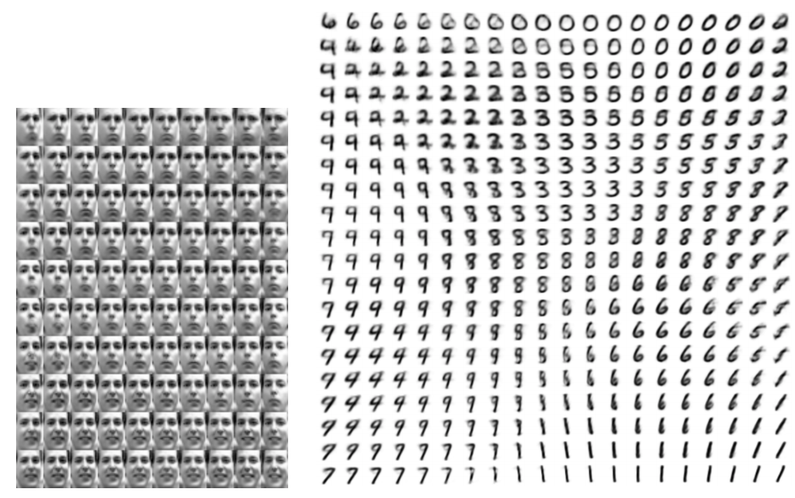
Original VAE results
Learned 2D “manifolds”:
D. Kingma and M. Welling, Auto-Encoding Variational Bayes, ICLR 2014

Slide 17
Original VAE results
Image source

Slide 18

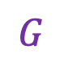
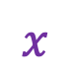

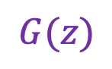
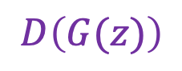


VAEs vs. GANs
VAEs offer more control over the latent space, explicit encoding
$$z$$
VAE training
$$x$$
Encoder
Decoder
$$\hat{x}$$
$$G(z)$$
GAN training
$$z$$
$$G$$
$$D$$
$$D\left(G(z)\right)$$

Slide 19
VAE pros and cons
Pros:
Principled mathematical formalism for generative models
Allows inference of code given image, can be useful for controlling the latent space
Cons:
Samples blurrier and lower quality compared to GANs
Active areas of research:
More powerful and flexible approximations for relevant probability distributions
Combining VAEs and GANs
Incorporating structure in latent variables, e.g., hierarchical or categorical distributions
Adapted from J. Johnson

Slide 20
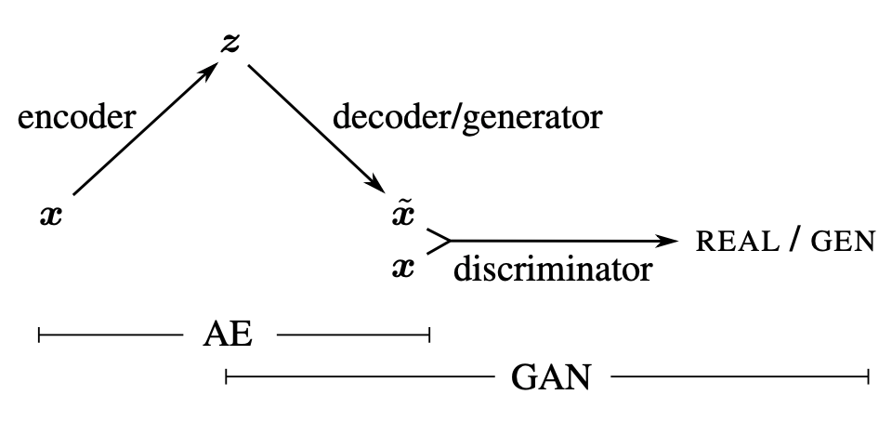
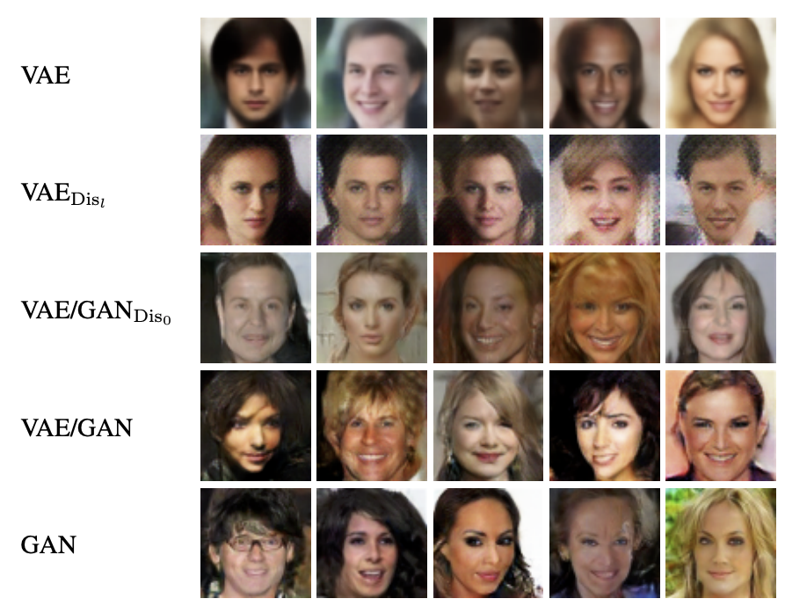
Combining VAEs and GANs
Define decoder probability model $p_{θ}(x|z)$ not in terms of reconstruction errors in pixel space, but in terms of errors in discriminator feature space
A. Larsen, S. Sonderby, H. Larochelle, O. Winther, Autoencoding beyond pixels using a learned similarity metric, ICML 2016

Slide 21
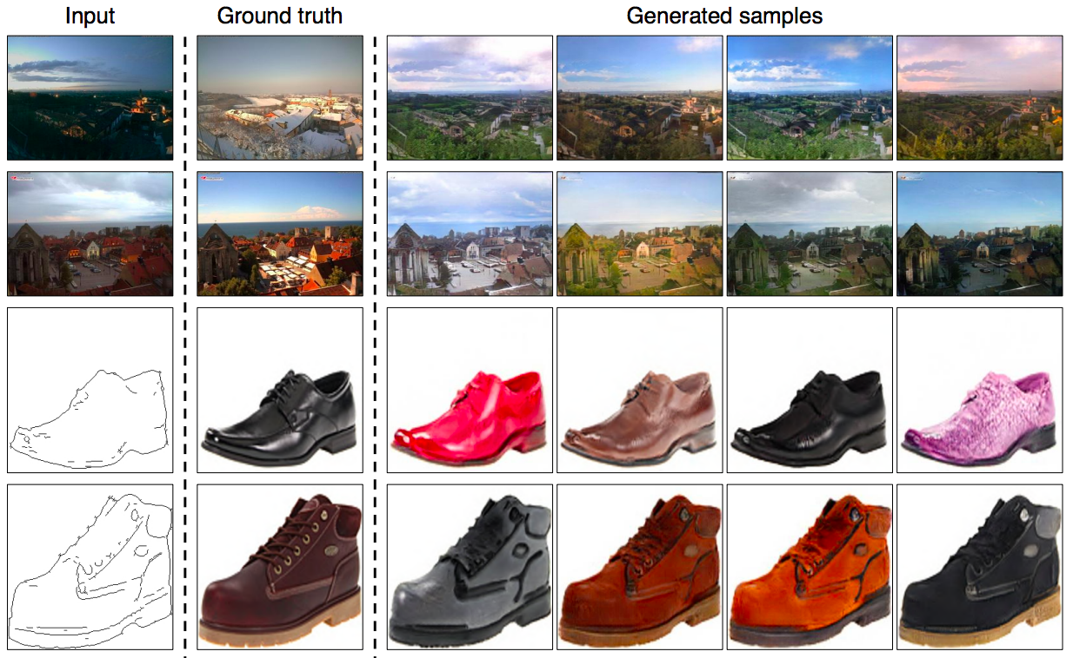
Combining VAEs and GANs: BicycleGANs
J.Y. Zhu, R. Zhang, D. Pathak, T. Darrell, A. A. Efros, O. Wang, E. Shechtman, Toward Multimodal Image-to-Image Translation, NIPS 2017

Slide 22
Combining VAEs and GANs: BicycleGANs
Key ideas:
Image-to-image translation is a one-to-many problem. Need to model conditional distribution of output given input parametrized by $z$
To prevent mode collapse (or many-to-one mapping from $z$ to output), need to encourage the mapping between output and latent code to be invertible
Propose BicycleGAN framework to simultaneously learn mappings in both directions
J.Y. Zhu, R. Zhang, D. Pathak, T. Darrell, A. A. Efros, O. Wang, E. Shechtman, Toward Multimodal Image-to-Image Translation, NIPS 2017

Slide 23
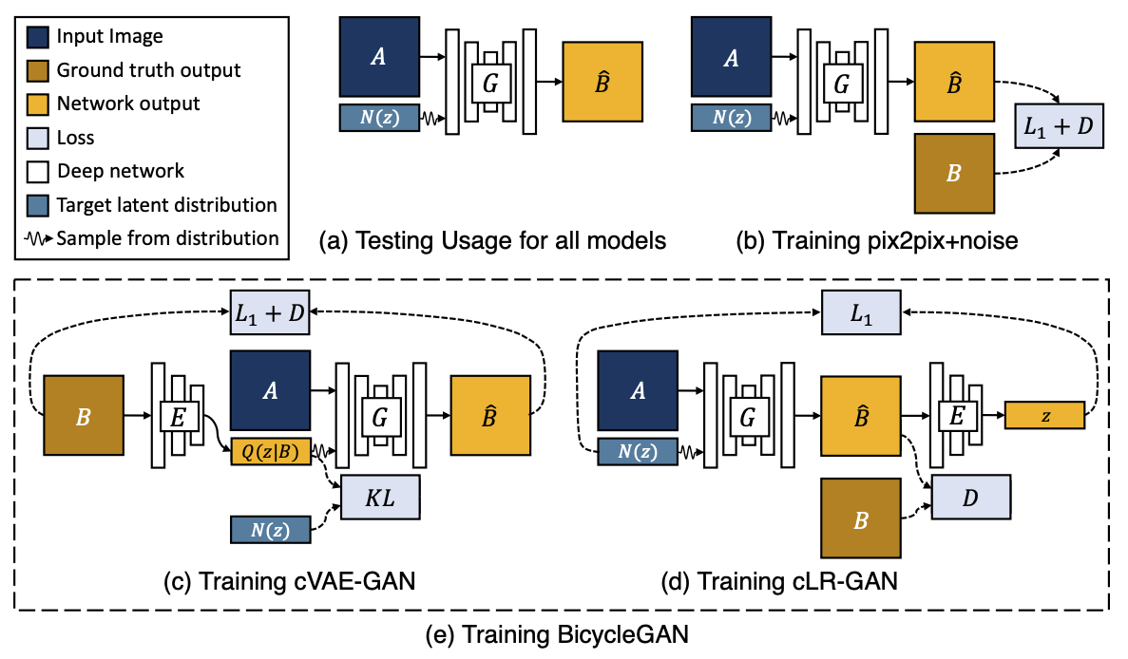
Combining VAEs and GANs: BicycleGANs
J.Y. Zhu, R. Zhang, D. Pathak, T. Darrell, A. A. Efros, O. Wang, E. Shechtman, Toward Multimodal Image-to-Image Translation, NIPS 2017
Notes:
From abstract: Many image-to-image translation problems are ambiguous, as a single input image may correspond to multiple possible outputs. In this work, we aim to model a distribution of possible outputs in a conditional generative modeling setting. The ambiguity of the mapping is distilled in a low-dimensional latent vector, which can be randomly sampled at test time. A generator learns to map the given input, combined with this latent code, to the output. We explicitly encourage the connection between output and the latent code to be invertible. This helps prevent a many-to-one mapping from the latent code to the output during training, also known as the problem of mode collapse, and produces more diverse results.

Slide 24
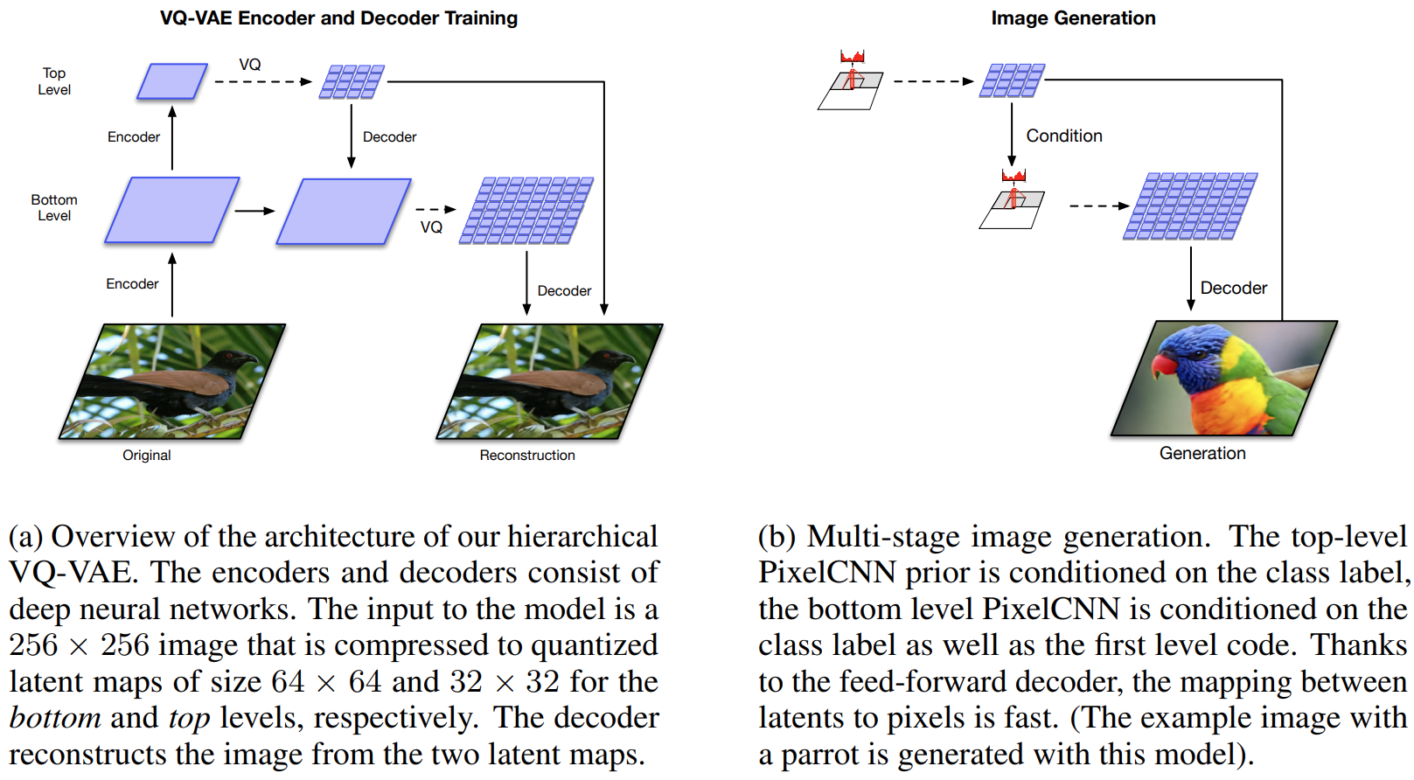
Generating better samples: VQ-VAE-2
Combining VAE and autoregressive models:
A. Razavi, A. van den Oord, O. Vinyals, Generating Diverse High-Fidelity Images with VQ-VAE-2, NeurIPS 2019
Notes:
We explore the use of Vector Quantized Variational AutoEncoder (VQ-VAE) models for large scale image generation. To this end, we scale and enhance the autoregressive priors used in VQ-VAE to generate synthetic samples of much higher coherence and fidelity than possible before. We use simple feed-forward encoder and decoder networks, making our model an attractive candidate for applications where the encoding and/or decoding speed is critical. Additionally, VQ-VAE requires sampling an autoregressive model only in the compressed latent space, which is an order of magnitude faster than sampling in the pixel space, especially for large images. We demonstrate that a multi-scale hierarchical organization of VQ-VAE, augmented with powerful priors over the latent codes, is able to generate samples with quality that rivals that of state of the art Generative Adversarial Networks on multifaceted datasets such as ImageNet, while not suffering from GAN’s known shortcomings such as mode collapse and lack of diversity

Slide 25
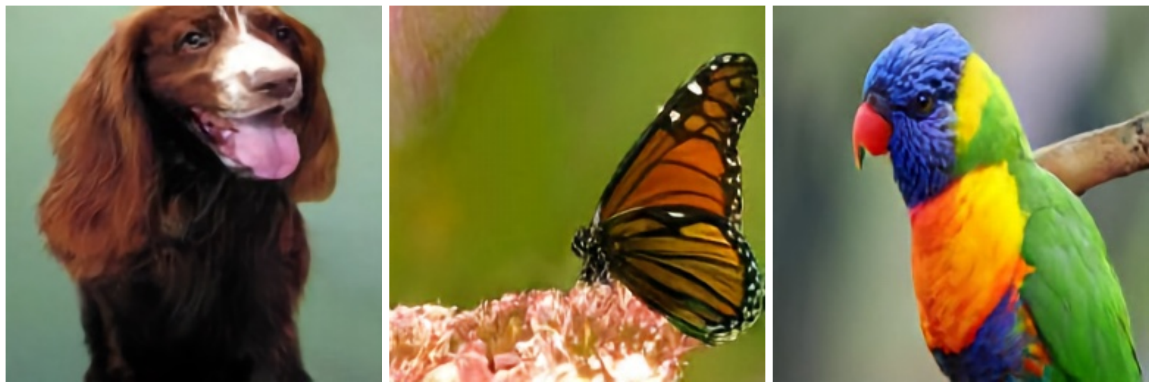
Generating better samples: VQ-VAE-2
256 x 256 class-conditional samples, trained on ImageNet:

Slide 26
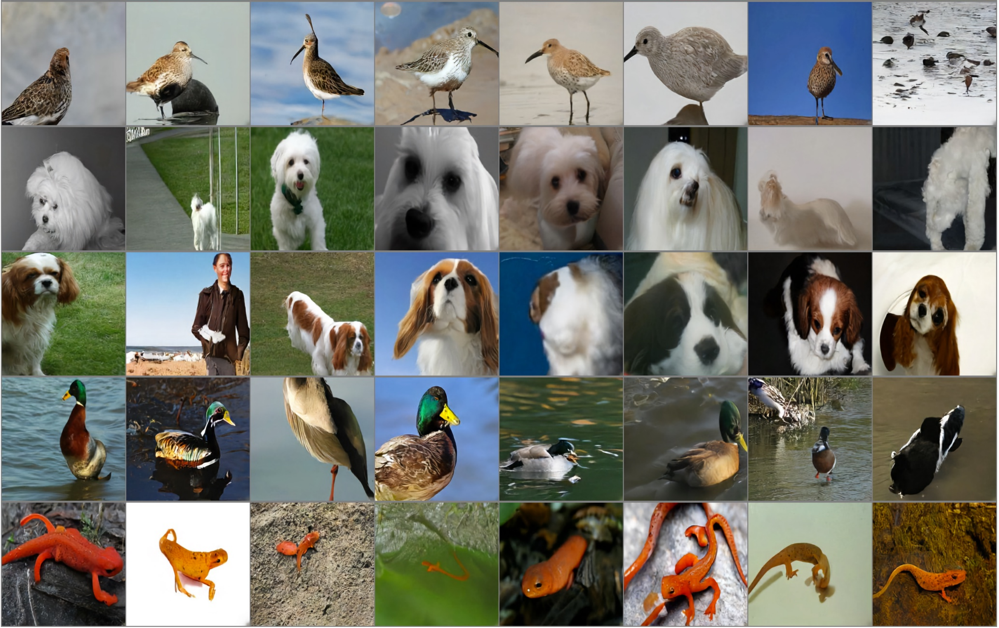
Generating better samples: VQ-VAE-2
256 x 256 class-conditional samples, trained on ImageNet:
Redshank
Pekinese
Papillon
Drake
Spotted Salamander

Slide 27
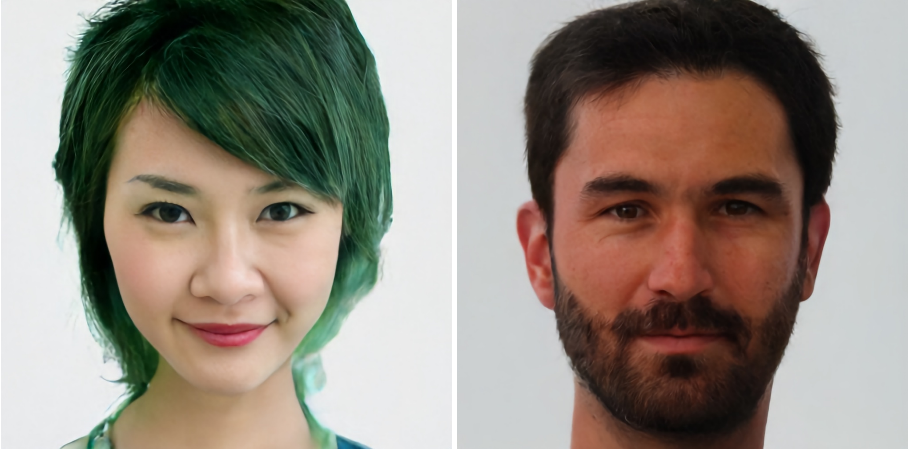
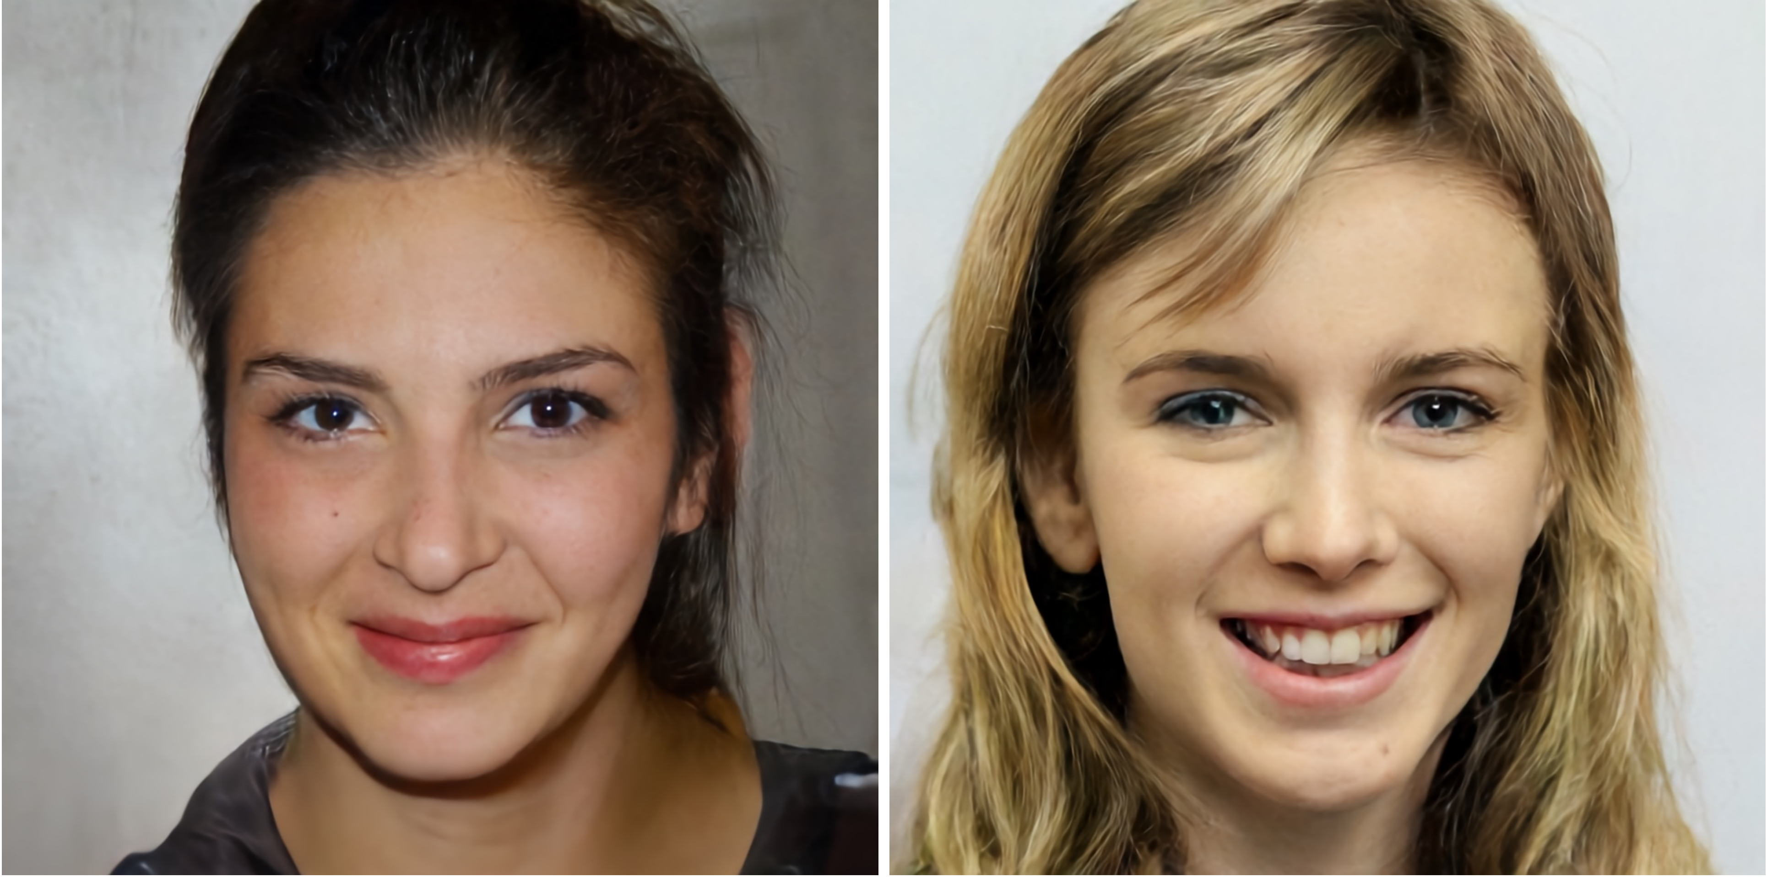
Generating better samples: VQ-VAE-2
1024 x 1024 generated faces, trained on FFHQ:

Slide 28
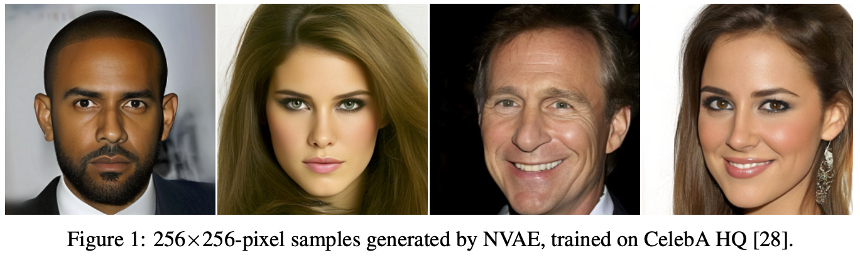
Generating better samples: Hierarchical VAE
A. Vahdat, J. Kautz, NVAE: A Deep Hierarchical Variational Autoencoder, NeurIPS 2020
Notes:
Normalizing flows, autoregressive models, variational autoencoders (VAEs), and deep energy-based models are competing likelihood-based frameworks for deep generative learning. Among them, VAEs have the advantage of fast and tractable sampling and easy-to-access encoding networks. However, they are currently outperformed by other models such as normalizing flows and autoregressive models. While most of the research in VAEs is focused on the statistical challenges, we explore the orthogonal direction of carefully designing neural architectures for hierarchical VAEs. We propose Nouveau VAE (NVAE), a deep hierarchical VAE built for image generation using depth-wise separable convolutions and batch normalization. NVAE is equipped with a residual parameterization of Normal distributions and its training is stabilized by spectral regularization. We show that NVAE achieves state-of-the-art results among non-autoregressive likelihood-based models on the MNIST, CIFAR-10, CelebA 64, and CelebA HQ datasets and it provides a strong baseline on FFHQ. For example, on CIFAR-10, NVAE pushes the state-of-the-art from 2.98 to 2.91 bits per dimension, and it produces high-quality images on CelebA HQ as shown in Fig. 1. To the best of our knowledge, NVAE is the first successful VAE applied to natural images as large as 256×256 pixels. The source code is available at

Slide 29
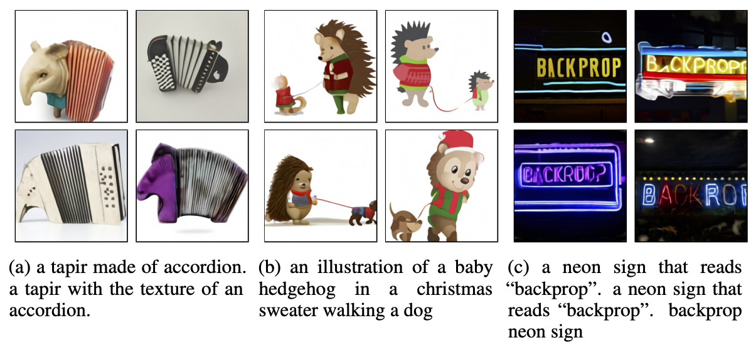
Combining VAEs and transformers: DALL-E
Train an encoder similar to VQ-VAE to compress images to 32x32 grids of discrete tokens (each assuming 8192 values)
Concatenate with text strings, learn a joint sequential transformer model that can be used to generate image based on text prompt
A. Ramesh et al., Zero-Shot Text-to-Image Generation, ICML 2021
https://openai.com/blog/dall-e/
Notes:
Text-to-image generation has traditionally focused on finding better modeling assumptions for training on a fixed dataset. These assumptions might involve complex architectures, auxiliary losses, or side information such as object part labels or segmentation masks supplied during training. We describe a simple approach for this task based on a transformer that autoregressively models the text and image tokens as a single stream of data. With sufficient data and scale, our approach is competitive with previous domain-specific models when evaluated in a zero-shot fashion.

